Slide 1

RAJIV GANDHI INSTITUTE OF TECHNOLOGY Department of Computer Science & Engineering
A VIRTUAL KEYBOARD BASED ON TRUE-3D OPTICAL RANGING
UNDER THE GUIDANCE OF:
Mrs. pushplata Dubey
Asst. professor dept of
Computer science
Presented by,
Mohammed touseef
(1rg17cs031)

Slide 2
TOPICS:
Introduction
Virtual keyboard technology
Different virtual keyboards
Applications
Advantages
Drawbacks

Slide 3
INTRODUCTION
Touch Typing Device
Compact And Faster
Use sensor technology and AI
Use infrared cameras to interact
Finger tracking based Interface
VKB has no physical support
Works on any surface
Used when our normal keyboard fails

Slide 4
VIRTUAL KEYBOARD TECHNOLOGY
The System Comprises Of Three Module:
The Sensor Module
IR Light Source
The Pattern projector

Slide 5
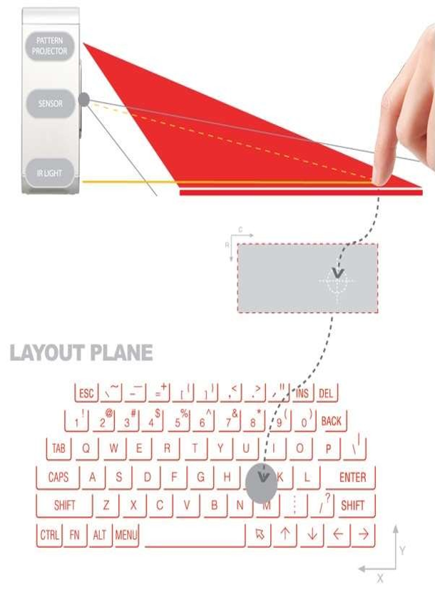
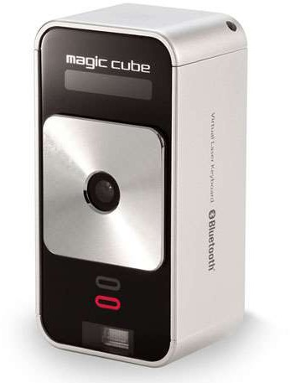

Slide 6
TYPES OF VIRTUAL KEYBOARD
VKB PROJECTION
SENSE BOARD
SCURRY
V TYPE

Slide 7

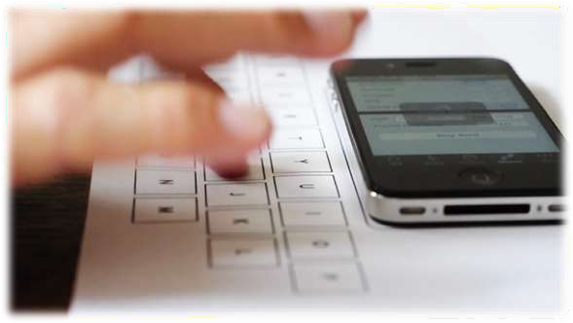
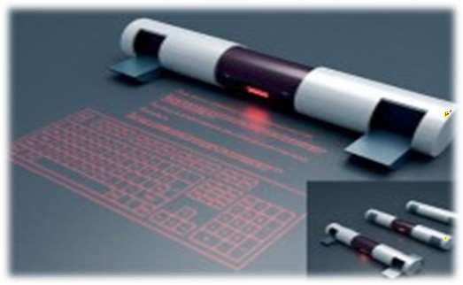
VKB PROJECTION
A projection keyboard is a form of computer input device whereby the image of a virtual keyboard is projected onto a surface: when a user touches the surface covered by an image of a key, the device records the corresponding keystroke.

Slide 8

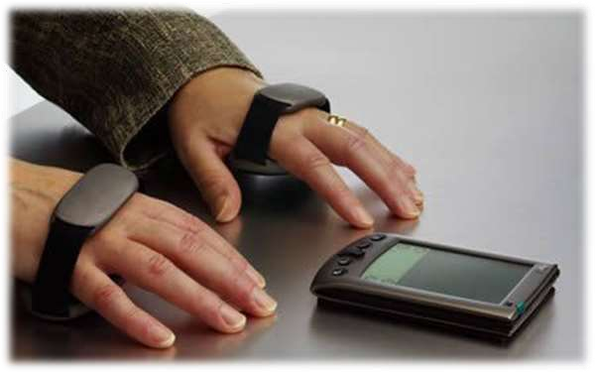


SENSE BOARD
Consists of two rubber pads that slips onto user’s hand
Muscle movements in the palm are sensed
Translates movements into key strokes by pattern recognition

Slide 9
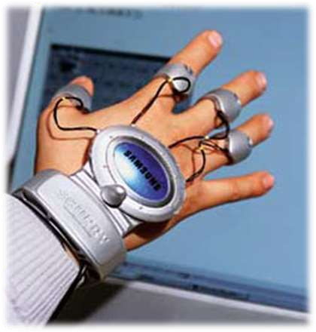



SCURRY
Operates computer by moving two hands in empty air
Next generation glove like, wearable device
Allows user to punch in letters without a keyboard

Slide 10
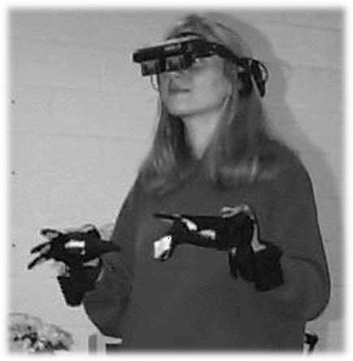


V TYPE
Detects key strokes in air with a given glove
Active finger tracking method is used

Slide 11
APPLICATIONS
In Operation Theaters
In high tech and Industrial sectors
Used with smart phones and PDA’s
In word processing, email and spread sheet tasks
As compute PDA input
Gaming control
TV remote control

Slide 12
ADVANTAGES
Laser can be projected on any surface or even in the air
Used where low noise is essential
Typing does not requires a lot of force
Touch typing paradigm can be adjusted
Plug and play device
No driver software necessary
High battery life

Slide 13
DRAWBACKS
VKB is hard to get used to
Typing in thin air requires a little practice
Projected keyboard should not be used in bright room
The devices are very costly

Slide 14
CONCLUSION
Provides the convenience of compactness with the advantages of a QWERTY keyboard
Based on a true-3D optical range camera
Used in 6th Sense Technology Device which does not depends on surface
Thus virtual keyboards will make typing easier, faster, and almost a pleasure

Slide 15
THANK YOU

